Slide 1

PROJECT HORIZON OF STARS
“you have to aim at the stars to reach the sun”
DOCUMENT SOFTWARE ARCHITECTURE V1.0
PROGRAMMER and software ARCHITECT WILLY THORPE

Slide 2

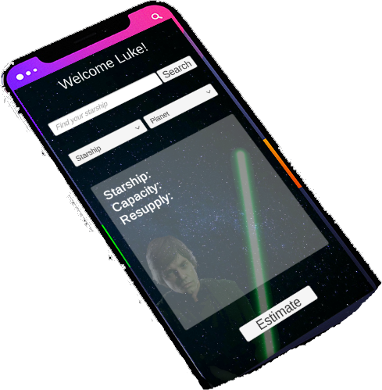
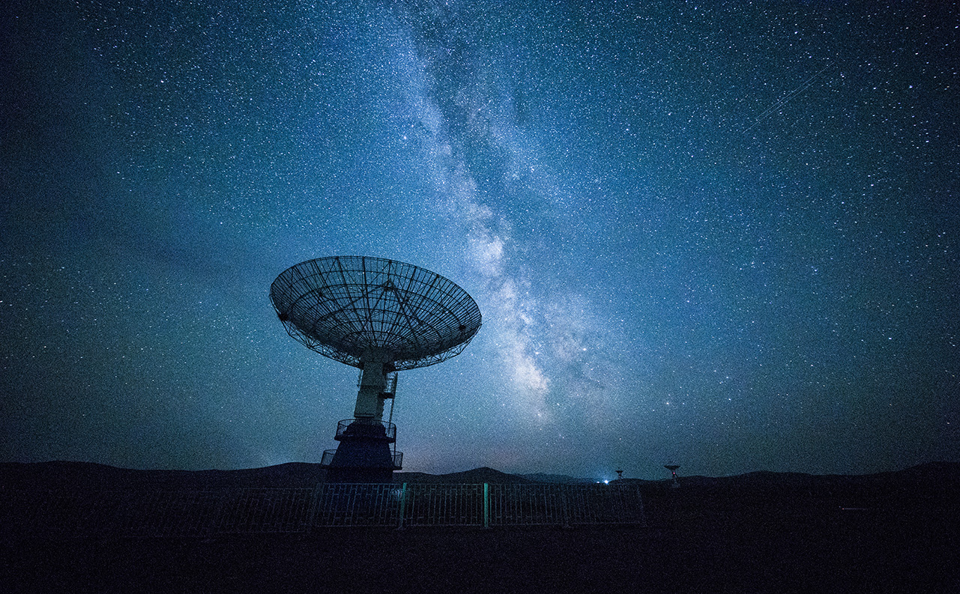
SOLUTION
Software architecture
AZURE SERVER LAYER ABSTRACTION
MICROSERVICE ESPECIALIZED
.NET C# + GRAPHQL
App mobile Unity + C#
API swapi.co
providing information
Service Database to forecast B.I. analysis
with information users
Providing interoperability for client devices

Slide 3
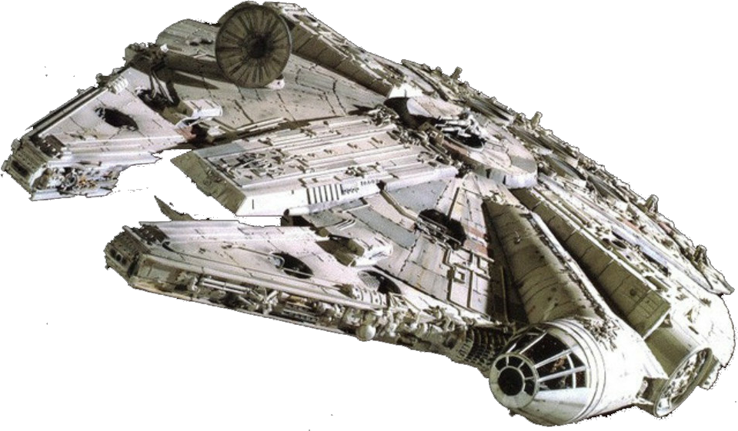
CALCULATION BASIS
SUN
EARTH
TARGET PLANET
Translation: 4848 DAYS
Orbital_period: 4848
SPEND ENERGY: 13 MGLT
Translation: 365 DAYS
Orbital_period: 365
ENERGY: 1 MGLT
Name: Falcon
Capacity: 75 MGLT
With the simple math three rule we have 13 MGLT away and 2 times needed for supply to arrival this target planet

Slide 4

WAS BUILT ONE LAYER ABSTRACTION ON AZURE SERVER WITH ARCHITECTURE SOA WITH SPECIALIZED MICROSERVICES AND THEIR RESPECTIVE ENDPOINTS providing interoperability for client devices
Solution .net core c# + wcf + azure services + graphql + mysql
API AZURE SERVER
http://api-horizonofstars.azurewebsites.net/API-HorizonOfStars.asmx
DOCUMENTATION and repository
SWAGGER
https://app.swaggerhub.com/apis-docs/willythorpe/HorizonofStars/1.0.0
GITHUB
https://github.com/willythorpe/horizonofstars
ENDPOINTS
RECOVER ALL PLANETS USING GRAPHQL TO BRING ONLY THE NECESSARY DATA
http://api-horizonofstars.azurewebsites.net/API-HorizonOfStars.asmx?op=GetAllPlanets
RECOVER ALL starships USING GRAPHQL TO BRING ONLY THE NECESSARY DATA
http://api-horizonofstars.azurewebsites.net/API-HorizonOfStars.asmx?op=GetAllStarships
RECOVER CALC MGLT NECESSARY UNTIL THE PLANET BASED ON EARTH AND SUN
http://api-horizonofstars.azurewebsites.net/API-HorizonOfStars.asmx?op=GetCalcMathMGLT
RECOVERS SHIP INFORMATION THROUGH GRAPHQL NAME SEARCH
http://api-horizonofstars.azurewebsites.net/API-HorizonOfStars.asmx?op=GetFilterStarship
CALCULATE HOW MANY STOPS WILL BE NECESSARY FOR THE SHIP TO REACH A PLANET
http://api-horizonofstars.azurewebsites.net/API-HorizonOfStars.asmx?op=calcStopResupply
INSERT INFORMATION TO EACH CONSULTATION OF USERS IN THE DATABASE FOR FUTURE B.I. ANALYSIS
http://api-horizonofstars.azurewebsites.net/API-HorizonOfStars.asmx?op=insertBI

Slide 5
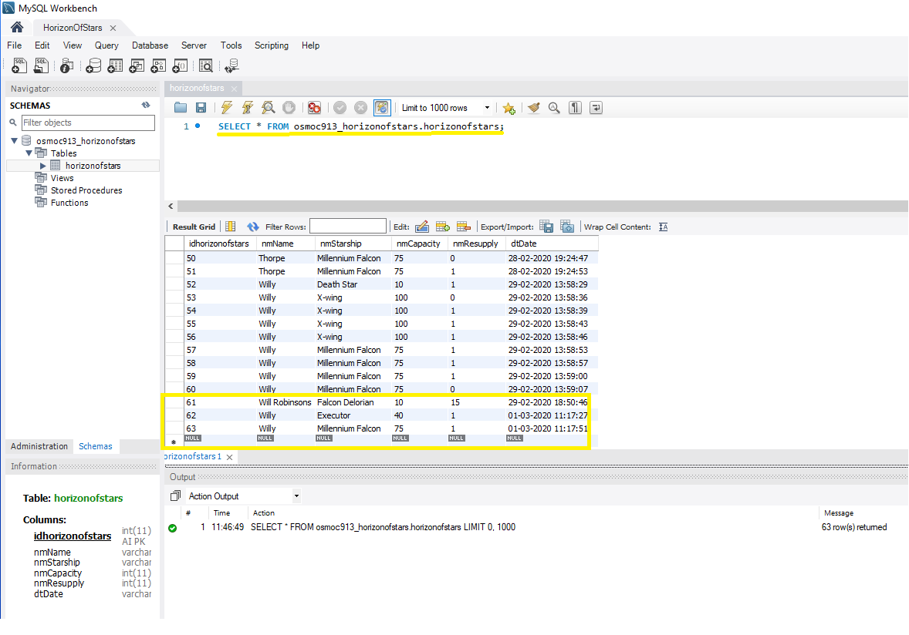
BUSINESS INTELIGENCE THE SYSTEM RECORDS INFORMATION FOR THE PREPARATION OF B.I. FUTURE AND FORECAST

Slide 6
THANK YOU FOR YOUR VALUABLE ATTENTION!
DREAMS ARE POSSIBLE WHEN WE BELIEVE IN IT

